Slide 1

WAN Automation Framework
Infrastructure Resiliency & Deployment Orchestration TechLink Solutions
High Availability – Reliability – Fault Tolerance – Resiliency - Scalability

Slide 2

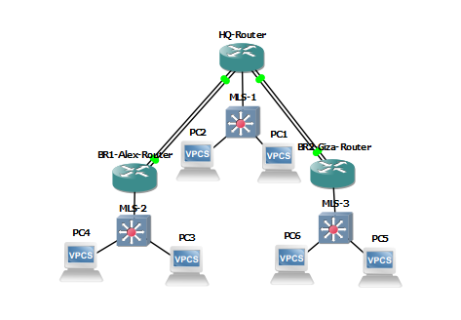

NETWORK TOPOLOGY OVERVIEW
Architecture & Topology Resilience
Strategic multi-branch footprint linking Cairo HQ core to Alexandria and Giza regional nodes.
•
Dual WAN Ingress: Redundant ISP paths per branch terminating on Core L3.
•
Performance & Efficiency: Optimizing traffic paths and localized routing decisions to preserve expensive WAN bandwidth and keep latency to an absolute minimum.
•
High Availability: Physical diversity across Gi1/0 to Gi4/0 interfaces.
Logical Segmentation: Strict separation of the management plane (VLAN 10) from end-user traffic (VLAN 20) across all local access ports

Slide 3





DYNAMIC ROUTING ENGINE
OSPF Area 0
Traffic Flow
Why OSPF
Single Backbone Area 0 configuration for maximum convergence speed and simplicity.
Sub-second RIB recalculation upon link state failure ensures zero-touch recovery.
dynamic neighbor discovery and zero manual route management
The Failover Mechanism
Link Failure
LSA Flood &LSDB updated
Recalculation & restoring

Slide 4
IP STRATEGIC ADDRESSING
Segment Role | Prefix | Subnet Mask | Design Rationale
WAN Point-to-Point | 192.168.x.x | 255.255.255.252 (/30) | Conserve space, minimize broadcast noise
Inter-Site Transit | 10.10.1.0 | 255.255.255.252 (/30) | L3 Core to Distribution Handoff
Branch LAN (Users) | 10.11.20.0 | 255.255.255.0 (/24) | Scalable local user segmentation
Branch Management | 10.11.10.0 | 255.255.255.0 (/24) | Isolated OOB management access

Slide 5
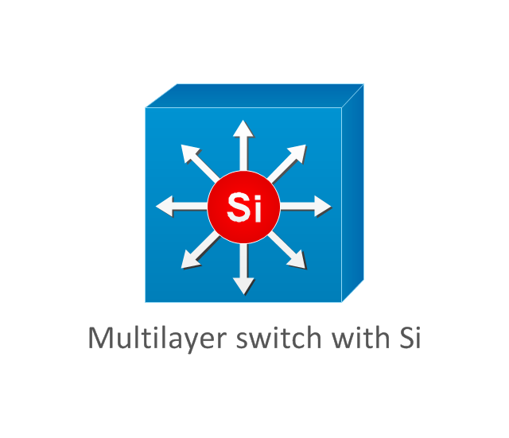
SWITCHING & SEGMENT ARCHITECTURE
Multilayer Switch (MLS)
Inter-VLAN Routing using SVIs
VLAN 10: Management SVI for device telemetry.
•
VLAN 20: End-user data segment with DHCP relay to Core.
•
Supports routing protocols
•
Transit: Routed port FE0/0 ( #no switchport) isolation on Multi-Layer Switches.
Zero-Trust system: Inbound Extended Access Control Lists (ACLs) bound on SVIs to block horizontal lateral movement between different VLANs.

Slide 6
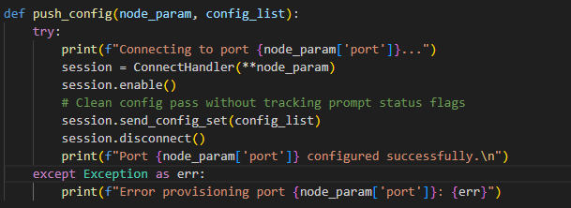
AUTOMATED PROVISIONING
Configuration Deployment Script (initial_deploy.py)
Deployment engine utilizing Python and Netmiko for zero-error baseline configuration.
•
Separation of Data and Logic
Programmatic Execution Engine (Netmiko ConnectHandler)
•
Advanced Dynamic Syntaxes: Dictionary unpacking (**node_param )
•
Defensive Programming Architecture: for fault isolation and mandatory socket teardown. try/except/finally
•

Slide 7
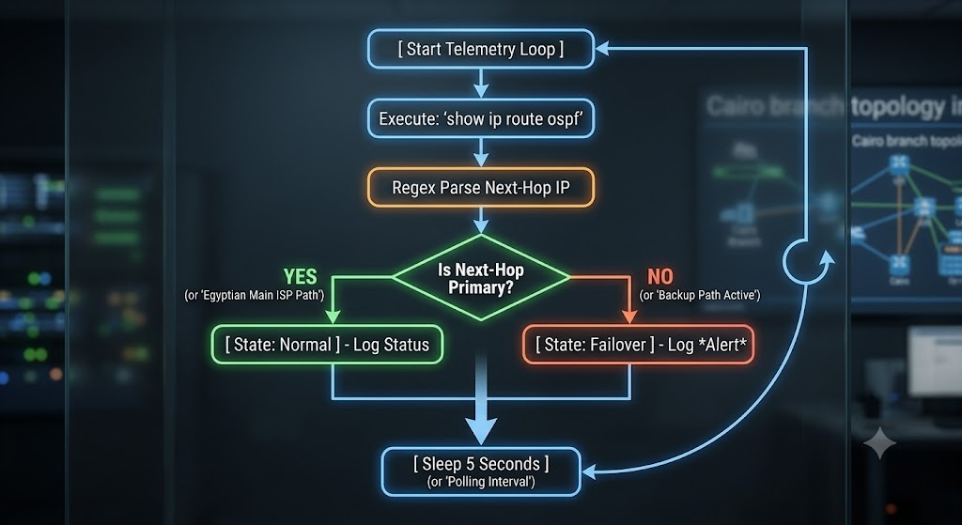
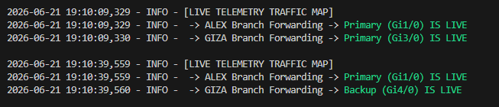
LIVE MONITORING TELEMETRY
Telemetry Logic
Background Monitoring Loop: Runs a continuous while True loop with a time.sleep(30) delay to check data without overloading the router CPU.
OSPF Route Parsing: Automates continuous text-matching on show ip route ospf to find and log active traffic interfaces instantly.
Dual-Stream Logging: Uses the Python logging library to send tracking data to the terminal screen and write a timestamped audit trail to network_status.log.

Slide 8

Ansible
a shift from raw "Scripting" to true Infrastructure as Code (IaC)
Agentless Framework: no specialized software or agents installed on routers or switches
Declarative Execution Model: handles the underlying execution mechanics natively.
Parallel Execution: using Fork concept instead of Sequential Mode device by device

Slide 9
Questions & Answers ??

